Slide 1
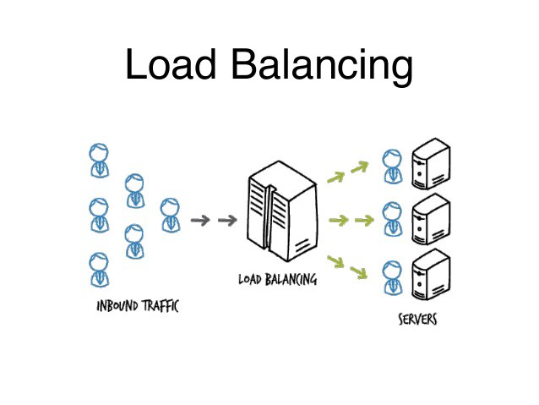

Slide 3
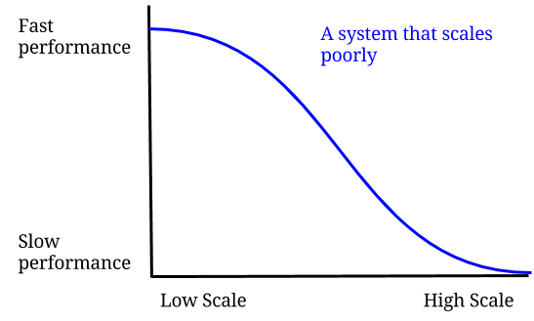

Slide 4
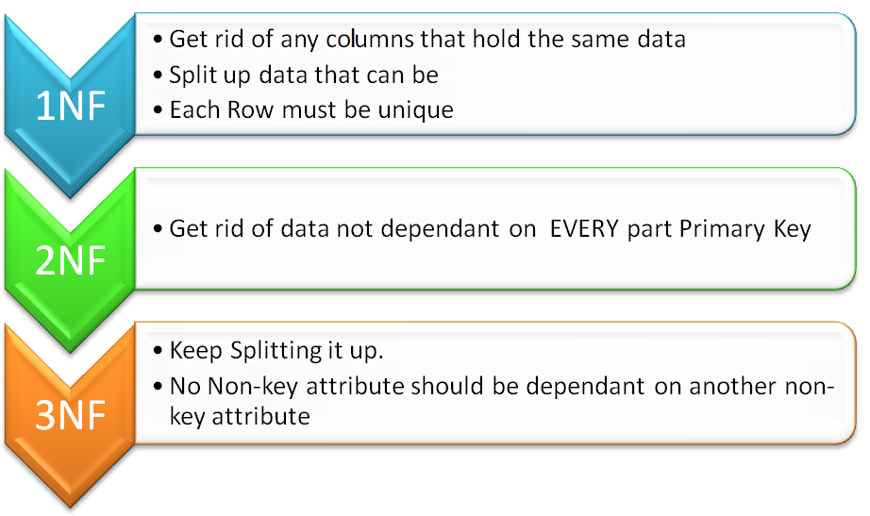
Normalisation - a process of organizing the data in database to avoid data redundancy and anomaly.

Slide 5
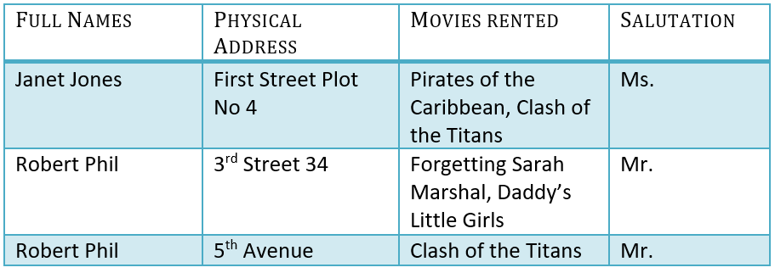
Un-normalised (raw)

Slide 6
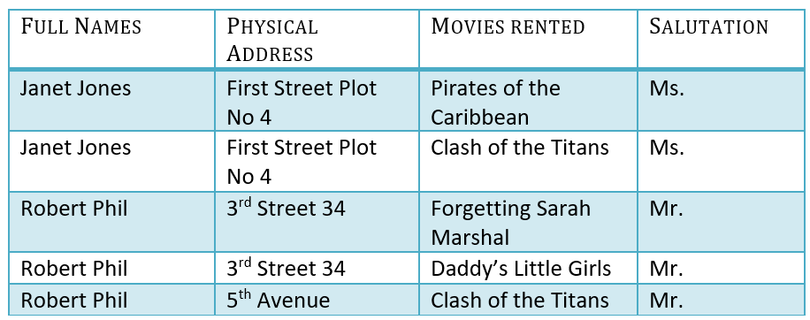
First Normal Form – unique records and atomic cells:

Slide 7
Second Normal Form – added single column Primary Key:

Slide 8
Third normal form – remove transitive functional dependencies (where X -> Y and Y -> Z, X -> Z). So this means membership ID can determine full name, full name can determine salutation, therefore Membership ID can determine Salutation:

Slide 9
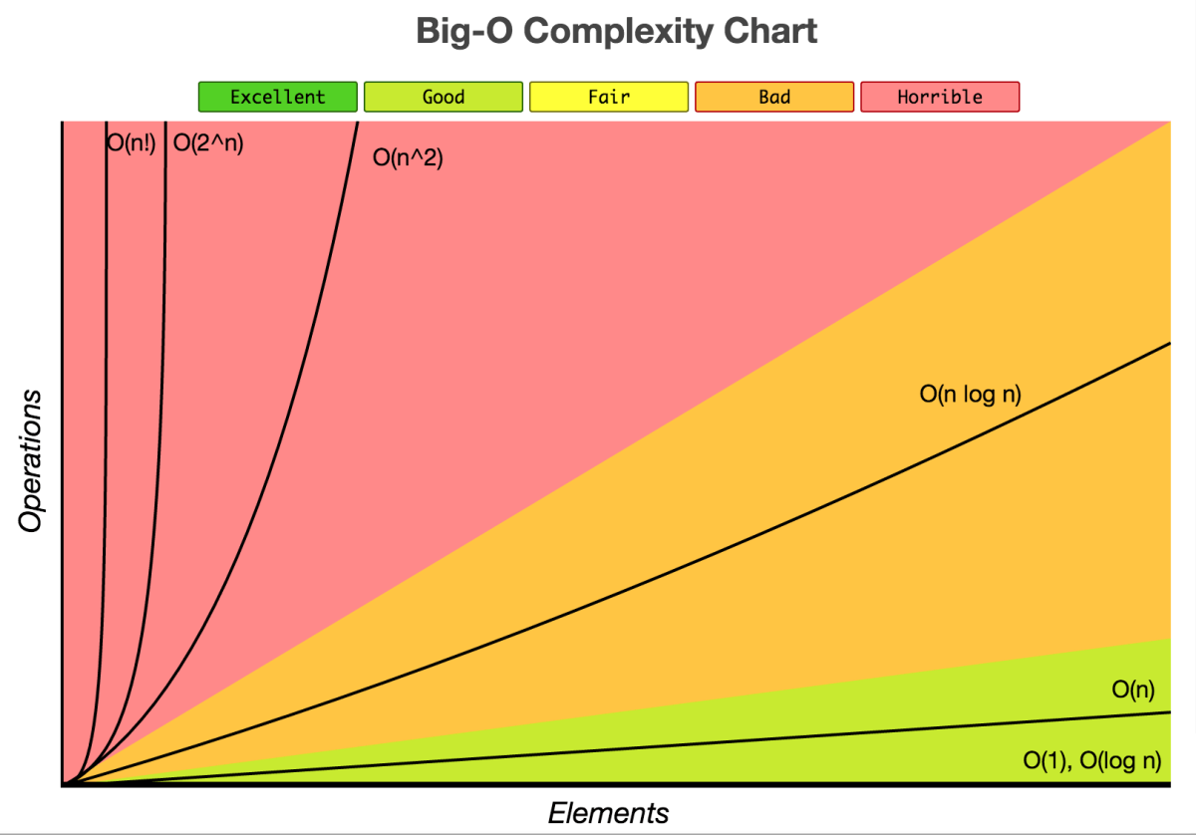

Slide 10
Algorithms with increasing complexity…
Simple:
Page navigation
Login or sign up
Browse data
CREATE, INSERT, DELETE, UPDATE
More complex:
Search
Sort
Rank
Filter
String manipulation
Very complex:
Match-making
Pattern analysis (data mining?)
Machine learning (e.g. prediction)
Other advanced or complex calculations, such as encryption methods, etc.
Are your algorithms technical proposal specific?

